Slide 1
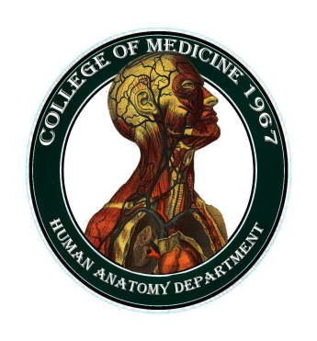
University of Basrah College of Medicine/ Department of Human Anatomy First Class
Medical Biology

Slide 2
Epithelial Tissue
Balqees kadhim

Slide 3
Objectives
What is epithelium
Mean characteristics of epithelium
Function of epithelium

Slide 4
Tissues
Are groups of cells that lie together to accomplish a common function.
During the early developments of embryo, there are three primitive germ layers: ectoderm, mesoderm, and endoderm. From these germ layers the tissues formed and the body is developed

Slide 5
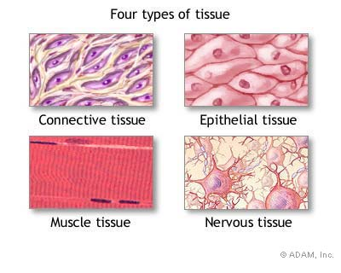
Histology
(groups of cells that are similar in structure and function)
4 Tissue Types

Slide 6
Epithelial cells are derived from all three embryonic germ layers which cover the body surfaces and line the body cavities.
Connective tissue derived from mesoderm which supports the other three basic tissues, both structurally and functionally
Muscle tissue derived from mesoderm which is made up of contractile cells specialized for contraction and movements.

Slide 7
Nervous tissue derived from ectoderm which composed of nervous cells that have the specialized functions of receiving, generating, and transmitting nerve impulses, and integrates information from outside and inside the body.

Slide 8
These tissues exist in association with one another and in variable proportions
Forming different organs and systems of the body.
The organ can be divided into:
Parenchyma which is composed of the cells responsible for the main function typical of the organ
stroma which is the supporting tissue.

Slide 9
Epithelial tissue
Is one of the four major tissue types in the body
acting as an interface between the body and the rest of the world.
Usually separated from the underlying connective tissue by a thin sheet of basement membrane.

Slide 10
Epithelial tissue
Has a special function–
It must cover all the surfaces of the body

Slide 11
Basal laminae and basement membrane
All epithelium rests on a sheet like extracellular structure called basal lamina that is not visible under the light microscope.
Basal lamina composed of ;
type IV collagen, laminin, entactin and proteoglycan.

Slide 12
The epithelial cells produce the basal lamina .
The term basement membrane usually contains two fused basal laminae or a laminae and reticular
Lamina (formed by connective tissue cells) are closely associated with the basal lamina, forming the reticular lamina.
The basal lamina forms a sieve like barrier between epithelial and connective tissue.

Slide 13
Functions of the basal lamina
-Structural support
provides strong connection between epithelium and underlying connective tissue.
-Filtering
forms a semi-permeable barrier to regulate the exchange of macromolecules between epithelium and underlying connective tissue

Slide 14
-Angiogenesis
Formation of new blood vessels
Basement membrane proteins have been found to facilitates differentiation of endothelial cells
These cells are essential for development of new blood vessels

Slide 15
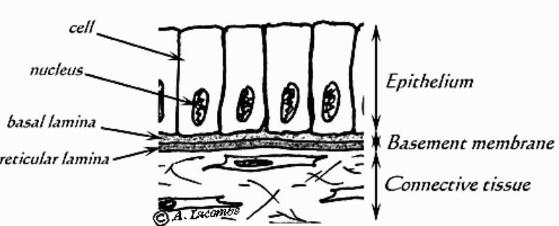
Diagrammatic illustration showing epithelial cells resting on basement membrane.

Slide 16
Main Characteristics of Epithelium
-An epithelium is a continuous sheet of connected cells.
-An epithelium contains very little extracellular matrix.
-An epithelium sits on a basal lamina.
-Epithelium does not contain blood vessels
-Derived from all embryonic germ layers.

Slide 17
These cells are often characterized by frequent cell division because they are exposed to wear and tear and injury, necessitating replacement.

Slide 18
Function of epithelium
Protection
-Epithelial cells from the skin protect underlying tissue from different conditions
Sensation
Specialized epithelial tissue containing sensory nerve endings to detect any changes in the external environment at their surface. like skin, eyes, ears, nose and the tongue.
.

Slide 19
Secretion
In glands, epithelial tissue is specialized to secrete specific chemical substances.
Absorption
Certain epithelial cells lining the small intestine absorb nutrients from the digestion of food.
Notes:
Cleaning

Slide 20
Excretion
Excrete waste product like Kidney and sweat gland
Diffusion
Simple epithelium promotes the diffusion of gases, liquids and nutrients like in lungs and capillaries.
Ciliated epithelium assists in removing dust particles and foreign bodies which have entered the air passages.
Cleaning

Slide 21
Reduces Friction
Epithelial cells that line the entire circulatory system reduce friction between the blood and the walls of the blood vessels.

Slide 22
Renewal of cell epithelia
The cells of epithelial tissue are capable of rapid division, which is the process that creates new cells.
The skin, constantly produces new cells to replace the dead cells closest to the skin's outer surface.
Also the cells of tissues lining the digestive tract are undergo continuous division.

Slide 23
Conclusion
Epithelial tissue is that it covers the surfaces of the body, whether external or internal.
It acts as a protective covering or boundary for such surfaces including the outer layer of the skin, as well as the inner surface of "hollow" organs like the stomach, colon, and blood vessels.

Slide 24
Cells are placed very close to each other
Intercellular space is absent or very little and so the intercellular matrix.
All epithelial tissues are supported by connective tissue.

Slide 25
The only way that epithelium can maintain its structure over the time is through continual division of stem cells.
Stem cells are found in the deepest layers of the epithelium ,near to the basement membrane.

Slide 26
